Slide 1
Lecture 1
Basics
C++ Programming
Konstantin Leladze
FCS HSE 2022

Slide 2
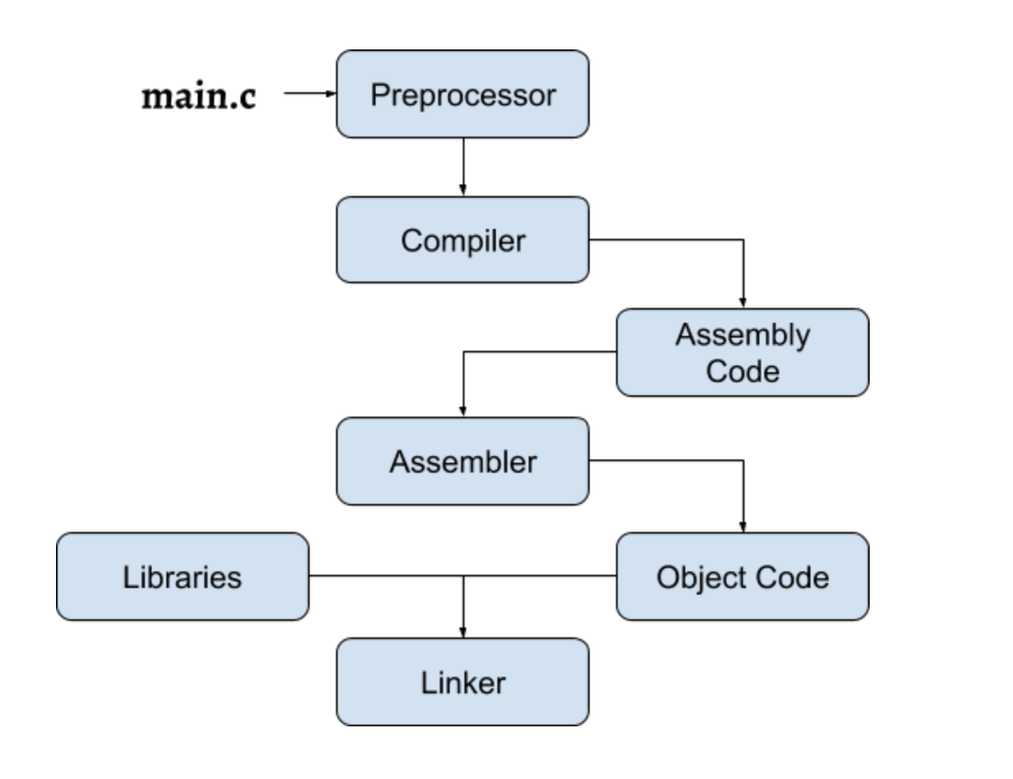
C++ language
Key features:
Compiled language
Multi-paradigm programming language:
Procedural
Object-oriented
Functional
Generic
Modular
Standardized
Language versions (according to standard):
C++98
C++03
C++07
C++11
C++14
C++17
C++20

Slide 3
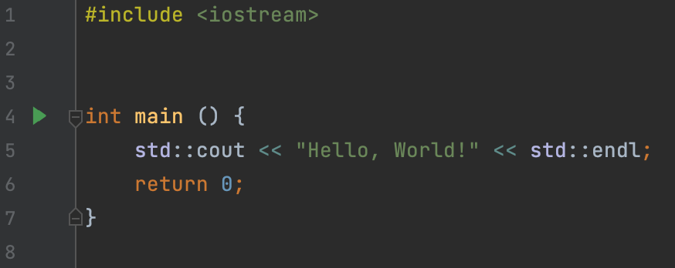
Program structure
A program is a sequence of instructions
A C++ program must have a main function.
Before the program code, you can specify header files. Example: #include <iostream>
Function body "is a sequence of instructions separated by a symbol ;
Usually, instructions are of three types: declaration, expression, control structure

Slide 4
Declarations
A declaration is a statement in two or three parts:
type identifier [= value or literal];
With a declaration, you can create a variable:
int x = 3;
Type:
In C ++, the type system is strict. This means that every variable in your code has one well-defined type. In Python, for example, this is not the case.
During the execution of your program, in the areas of RAM allocated for storing your local variables a new space of size corresponding to the size of the type of your variable is allocated in result of the declaration instruction.
Each type has a numeric value called the size of the type, which indicates how much space variables of this type take up in RAM.

Slide 5
Fundamental types
C ++ has a specific set of built-in types:
Integer variables: store only integer (possibly negative) values
Real variables: store an arbitrary real number
Boolean variables: store one of two possible values: true or false.
Character variables: store an arbitrary character from an ASCII table (will discuss that later)
int Size: 4 bytes. Stores integers in the range [-2 ^ 31, 2 ^ 31 - 1]
unsigned Size: 4 bytes. Stores positive integers in the range [0, 2 ^ 32 - 1]
long long Size: 8 bytes. Stores integers in the range [-2 ^ 63, 2 ^ 63 - 1]
unsigned long long Size: 8 bytes. Stores positive integers in the range [0, 2 ^ 64 - 1]
float Size: 4 bytes. Stores an approximate value of a real number
double Size: 8 bytes. Stores an approximate value of the a number with double precision
long double Size: 16 bytes. Stores an approximate value of the a number with 4x precision
bool Size: 1 byte. Stores a Boolean value: true or false
char Size: 1 byte. Stores a character from ASCII table

Slide 6
Identifiers
Any sequence of Latin letters, numbers and underscores that does not begin with a number and is not a keyword can be used as an identifier.
Example:
a_simple_identifier
x_dir1
Keywords:
if
else
for
do
while
switch
class
…
NON-Keywords:
vector
map
cout
cin
endl
list
array
…

Slide 7
Literals
A literal is a typed special value that can be used to initialize a variable.
most primitive types have literals of their own.
Examples:
1 int
’a’ char
true bool
false bool
“abc” string literal (will discuss later)
0.2f float literal
0.3 double literal
nullptr pointer literal (will discuss later)

Slide 8
Variable definitions with literals
Examples: int x = 5; bool y = true; float z = 5.1f; double k = 5.0; long long p = 5ll; unsigned long long q = 4ull;
Implicit type conversions
if you try to initialize a variable of a certain type with a certain literal of another type, in some cases it will work (and in some it will be an error).
Examples:
int x = 5.8;
bool y = 1;
float z = 5.1;
double k = 5;

Slide 9
Other examples of implicit conversions
bool <–> int implicit conversions:
bool –> int:
false –> 0
true –> 1
int –> bool:
0 –> false
Every other number –> true
Rule: when converting between types of different sizes, it is important to follow the rule: a number that can be converted to a specific type should not exceed the range of values ​​of this type. Otherwise, a certain complex and ambiguous situation will occur, which is called overflow.
Some more examples of implicit type conversions:
‘a’ + ‘b’ –> int char –> int
5/3 –> int division operator (will be discussed later) results in integer
long long x = 5 int –> long long

Slide 10
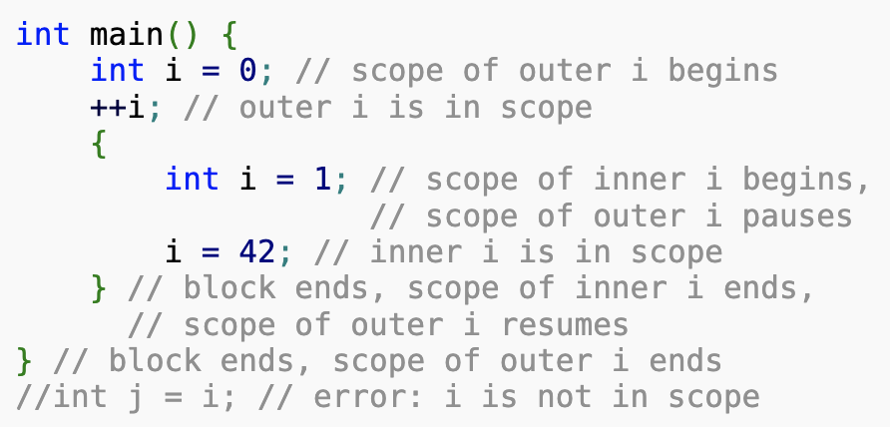
Scopes
Each name that appears in a C++ program is only visible in some possibly discontiguous portion of the source code called its scope.
Within a scope, unqualified name lookup can be used to associate the name with its declaration.
There are different kinds of scopes: block scope, function arguments scope, namespace scope, enumeration scope, class scope, etc. But today we will only talk about one of them: block scope.
Block scope
The potential scope of a name declared in a block (compound statement) begins at the point of declaration and ends at the end of the block. Actual scope is the same as potential scope unless an identical name is declared in a nested block, in which case the potential scope of the name in the nested block is excluded from the actual scope of the name in the enclosing block.

Slide 11
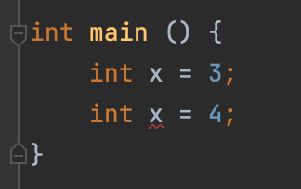
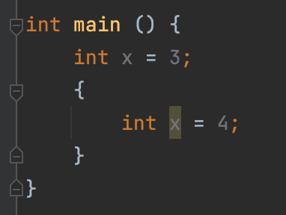
Scopes
One definition rule:
A variable with a certain identifier can only be defined once in a scope.
Error:
BUT this code is ok:

Slide 12
Expressions
Most of a C ++ program is expressions.
An expression is some combination of literals and identifiers separated by operators.
Examples:
5 + x;
2;
++ y;
An operator, in computer programming, is a symbol that usually represents an action. These symbols were adapted from mathematics and logic. An operator is capable of manipulating a certain value or operand.
For example, operator + has two operands and the result is the sum of the operands.
Operator precedence determines the grouping of terms in an expression: Within an expression, higher precedence operators will be evaluated first.
The associativity of an operator is a property that determines how operators of the same precedence are grouped in the absence of parentheses.

Slide 13
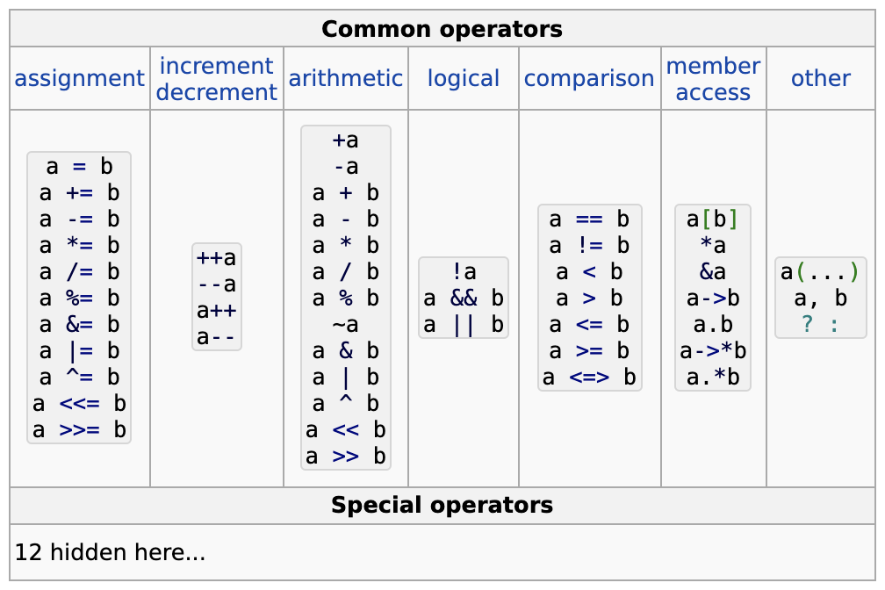
Operators

Slide 14
Assignment operator
Assignment operator is a binary operator: a = b value of a variable can be changed with the help of an assignment operator: x = 4
Precedence: 16.
Associativity: right-to-left
Note: Don’t confuse assignment operator with variable initialization!
Assignment operator:
int x;
x = 4;
Variable initialization:
int x = 3;
Note: Assignment operator returns the assigned value.
int x = 0;
std::cout << (x = 3) << std::endl;
Will print out 3, because x = 3 returns new value of x which is 3.
This idea can be used to assign multiple variables to the same value:
x = y = z = 3;

Slide 15
Lvalue and rvalue
lvalue and rvalue in C++ 07:
If a value can be used as the left operand of the assignment operator, then it is called an lvalue.
Otherwise, it is called an rvalue.
Note: In C++ 11 the value mechanism has been changed dramatically.
OK (x is an lvalue):
int x = 3;
int y = 5;
x = 7;
Incorrect (5 is an rvalue):
int x = 3;
5 = x;

Slide 16
Arithmetic operators
Binary operators:
Addition: a + b
Subtraction: a - b
Multiplication: a * b Division: a / b
Remainder: a % b
Presedence: *, /, % operators: 5
+, – operators: 6
Associativy: left-to-right
Unary operators:
Unary plus: + a
Unary minus: - a
Use case of unary –: int x = - y;
Use case of unary +: will be shown later.
Presedence: 3
Associativy: right-to-left
Note 1: In C++, division of two integers will also return integer: 7 / 3 = 2
Note 2: Remainder operator should be applied only to integer types: 7 % 3 = 1

Slide 17
Compound assignment arithmetic operators
Special binary operators +=, -=, *=, /=, %= are named compound assignment arithmetic operators.
Presedence: 16 (same as assignment operator)
Associativity: right-to-left (same as assignment operator)
Theese operators should be used to increase or decrease the value of the variable (let x be 5):
x *= 3;
Now x is 15.
Just like the assignment operator, left operand of compound assignment arithmetic operator should be lvalue (for example, this is prohibited: 5 += 4, because 5 is an rvalue and not an lvalue)
Just like the assignment operator, compound assignment arithmetic operators return the new value of the assigned variable (let x be 2 by default):
std::cout << (x -= 3) << std::endl;
Will print out -1, because x -= 3 returns new value of x, which is -1
This idea can be used to update multiple variables. For example (let x, y and z be 5 by default):
z /= x += y *= z %= x -= 3;

Slide 18
Increment and decrement operators
Unary operators:
Prefix increment: ++ a
Prefix decrement: -- a
Postfix increment: a ++ Postfix decrement: a --
Presedence: Postfix operators: 2
Prefix operators: 3 (Same as unary + and –)
Associativy: Postfix operators: left-to-right
Prefix operators: right-to-left
Note: Just like the compound assignment operators, increment and decrement operators should be provided with an lvalue as an operand.
Note: both prefix and postfix increment operators increase the value of the variable by 1. Both prefix and postfix decrement operators decrease the value of the variable by 1.
Note: prefix increment or decrement operators return the new value of the varible, when postfix increment and decrement operators return the previous value the variable
Example (let x be 0 by default):
std::cout << x++ << std::endl;
std::cout << ++x << std::endl;
Will print out 0 and then 2.

Slide 19
Comparison operators
Binary operators:
equal: a == b
not equal: a != b
less: a < b
less or equal: a <= b
greater: a > b greater or equal: a >= b
Presedence: Relational operators: 9
Equality operators: 10
Associativy: left-to-right
Note: theese operators are used to compare numbers, they return boolean value which indicates the result of the comparison.
Example:
int x = 4;
int y = 5;
std::cout << (x < y) << std::endl;
prints out 1 (true)
std::cout << (y == x) << std::endl;
prints out 0 (false)
etc…

Slide 20
Logical operators
Binary operators:
Logical not: !a
Logical and: a && b
Logical or: a || b
Presedence: Logical not: 3
Logical and: 14
Logical or: 15
Associativy: left-to-right
Note: theese operators are used to calculate the values ​​of logical expressions. Boolean values ​​are passed to these operators, and the output is also a Boolean value.
Example:
bool x = true;
bool y = false;
std::cout << (x && y) << std::endl;
prints out 0 (false)
std::cout << (x || y) << std::endl;
prints out 1 (true)
y = !y
std::cout << (x && y) << std::endl;
prints out 1 (true)

Slide 21
Operator sizeof
Operator sizeof:
Receives name of the type, literal, or identifier and returns an amount of bytes, needed for provided value to be stored in memory.
Examples (true for apple clang-1205.0.22.9 compiler and the majority of other compilers):
sizeof(int) returns 4
sizeof(54) also returns 4 (because 54 is int literal)
sizeof(123ull) returns 8 (because 123ull is an unsigned long long literal)
sizeof(‘a’) returns 1 (because ‘a’ is a char literal)
etc…

Slide 22
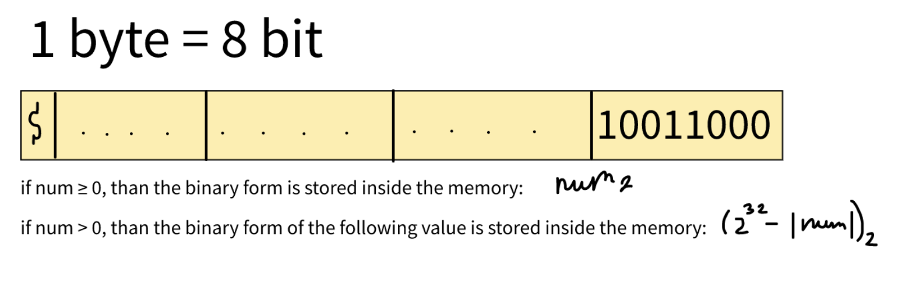
Storing integers in memory
Integer variables are stored as a sequence of bits (zeros or ones):

Slide 23
Storing other integer types in memory
The same mechanism is applied for other signed integer types (but size of the memory block will be different):
short: 2 Bytes
int : 4 Bytes
long : 4 Bytes
long long : 8 Bytes
Note: sizes of theese types are not standardized, i.e. they can be different, but the following rule must be preserved:
sizeof(short) ≤ sizeof(int) ≤ sizeof(long) ≤ sizeof(long long)

Slide 24
Storing unsigned integer types in memory
For unsigned integers, the formula is simpler: the binary form of the variable is just stored inside the memory, i.e. there is no sign bit for unsigned variables.
unsigned short: 2 Bytes
unsigned int (or just unsigned): 4 Bytes
unsigned long: 4 Bytes
unsigned long long : 8 Bytes

Slide 25
Bitwise operators
Unary operator:
Bitwise not: ~a
Binary operators:
Bitwise and: a & b
Bitwise xor: a ^ b
Bitwise or: a | b
Bitwise left shift: a << b
Bitwise right shift: a >> b
Presedence: Bitwise not: 3
Bitwise shifts: 7
Bitwise and: 11
Bitwise xor: 12
Bitwise or: 13
Associativy: left-to-right
Note: theese operators are used to operate with bits of the variables.
Semantics:
~a returns bitwise invertion of the number.
a & b, a | b, a ^ b applies and, or and xor operations to the variables a and b respectively.
a << b, a >> b shifts the binary representation of the number a by b bites to the left and right respectively.
Note: there is a compound assignment version of each binary bitwise operator: &=, ^=, |=, <<=, >>=
Presedence: 16
Associativity: right-to-left (same as every other assignement operator)

Slide 26
Ternary operator
Ternary operator:
a ? b : c
Presedence: 16 (same as assignement operators)
Associativy: left-to-right
Semantics:
a – boolean expression
b and c should be of the same type (or should be convertible to the same type)
Ternary operator returns b if a is true, otherwise c.
Example:
int a = 5;
int b = 3;
int max_two = (a > b) ? a : b;

Slide 27
Other operators
C-style cast:
(type)
Presedence: 3 (same as assignement operators)
Associativy: right-to-left
Semantics:
casts expression to the given type
Example:
unsigned short a = (unsigned short)5 + (unsigned short)true;

Slide 28
Scope resolution operator
Scope resolution (aka four dots operators):
::
Presedence: 1 (highest possible)
Associativy: left-to-right
Example:
std::cout << … << std::endl;

Slide 29
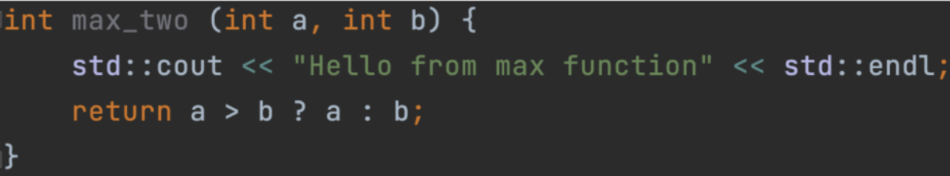
Functions
In C++, you can create functions in order to avoid copypaste and combine specific logic. For example, calculation of the n-th Fibbonacci number, or calculating max of two values.
return type
name
arguments
function body

Slide 30
Operator function call
In order to call your function, you should use operator function call:
func_id(arg1, arg2, …, argn);
Presedence: 2
Associativy: left-to-right
Note:
arguments are not guaranteed to be calculated sequentially from left to right!

Slide 31
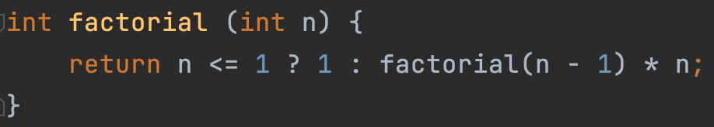
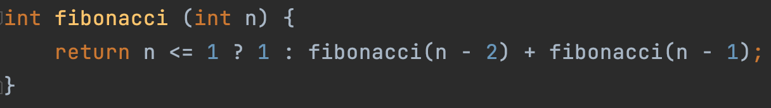
Recursion
In C++, you can call a function from within itself:

Slide 32
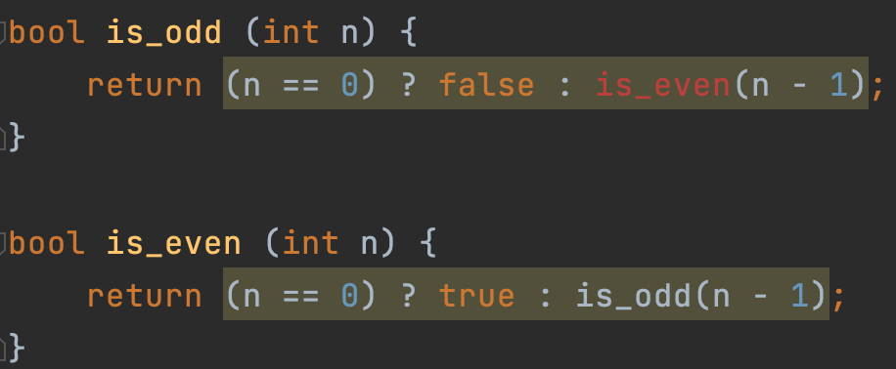
Function declaration
How to you compile this code =( ?

Slide 33
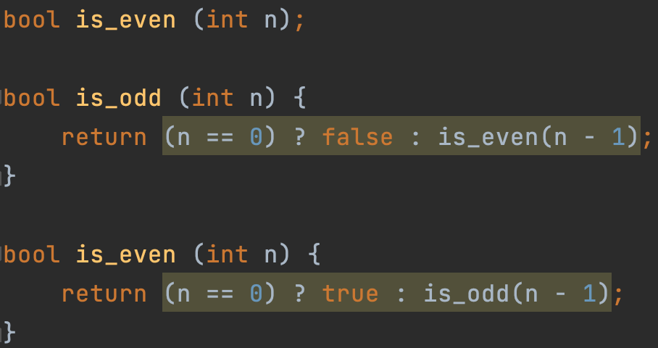
Function declaration
Solution: predeclare the second function:

Slide 34
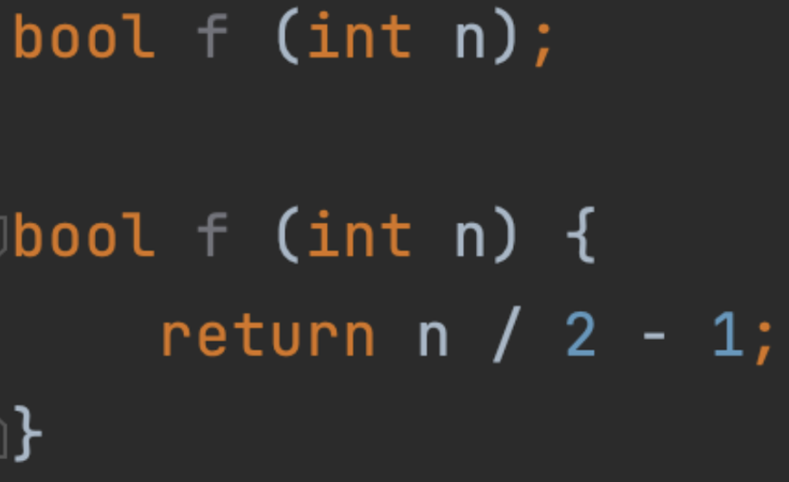
Declaration vs definition
Function can be declared multiple times, but should be defined only once!
Declaration
Definition

Slide 35
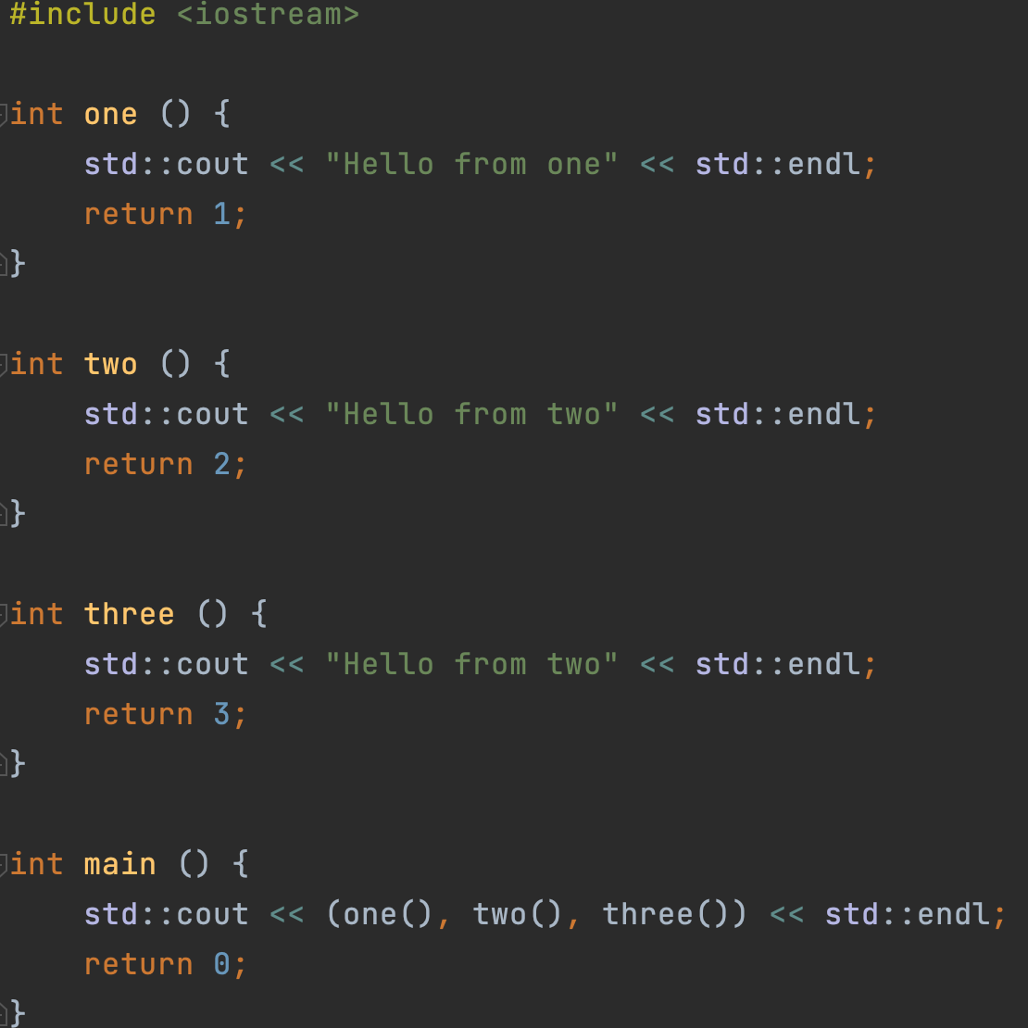
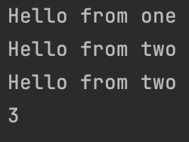
Comma operator
Comma operator:
,
Presedence: 17 (lowest possible)
Associativy: left-to-right
Usage:
Calculates the left argument, then the right argument and returns the result of right argument

Slide 36
Logical operators vs Bitwise operators
Optimisations:
In the case of operator &&, if the first argument evaluates to false, then, the second argument isn’t getting calculated, because the result of the expression can already be predicted.
The same rule is followed in the case of operator || if the first argument evaluates to true.
But there is no such rule for bitwise operators | and &
So, operators | and & are also applicable for boolean expressions too!
(If you want to force the calculation of both arguments)

Slide 37
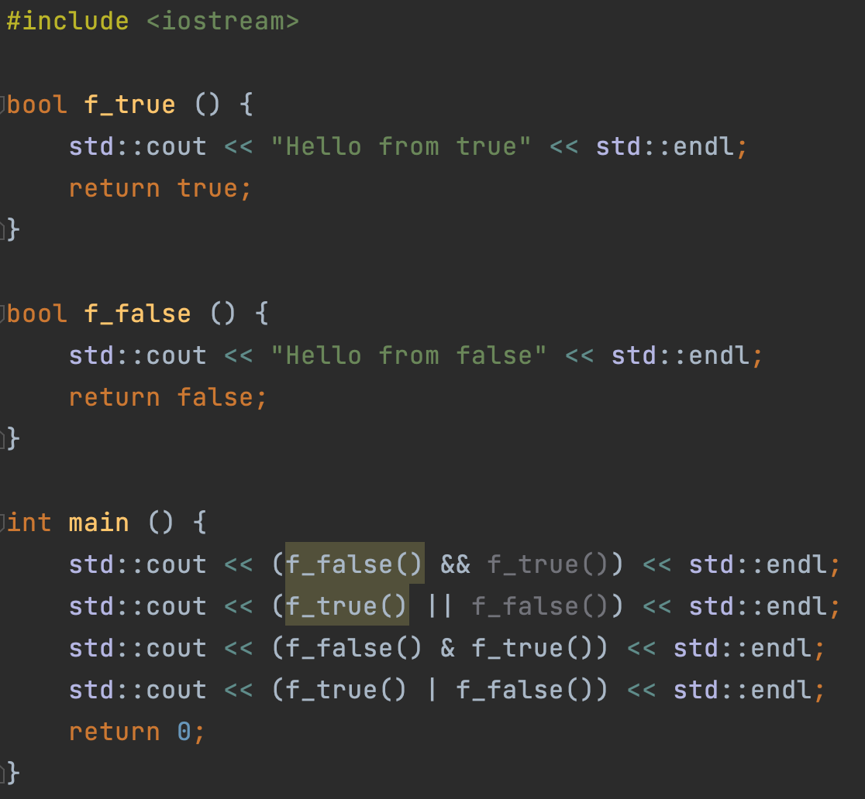
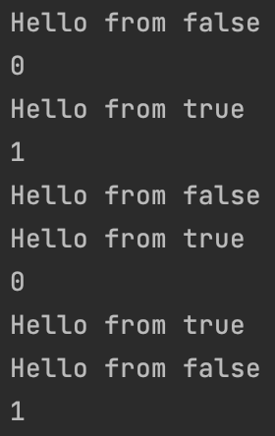
Logical operators vs Bitwise operators

Slide 38
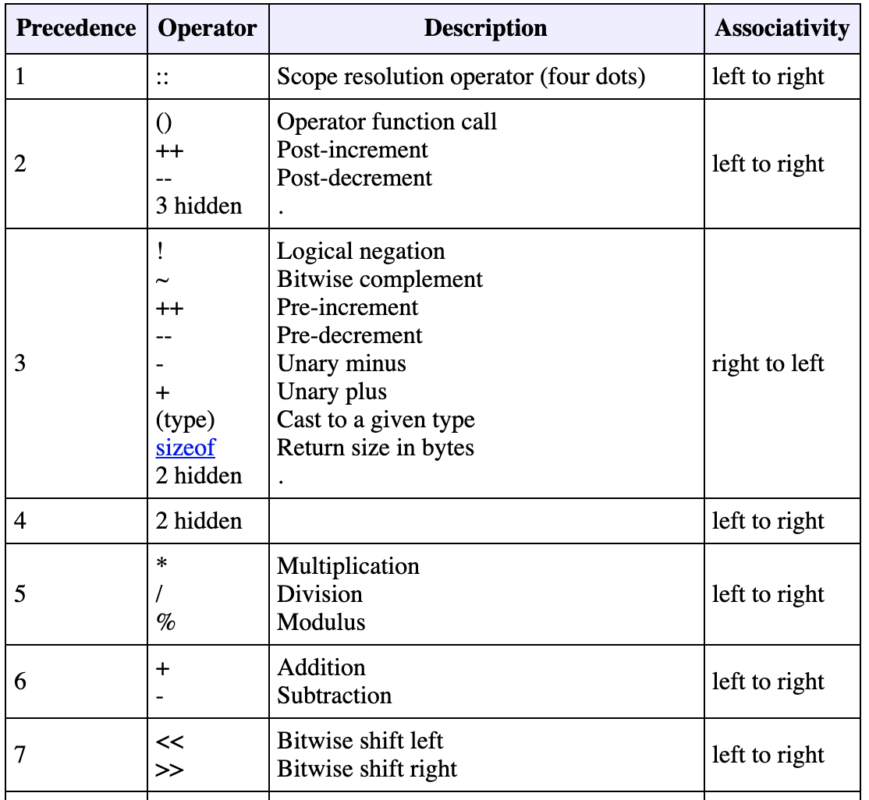
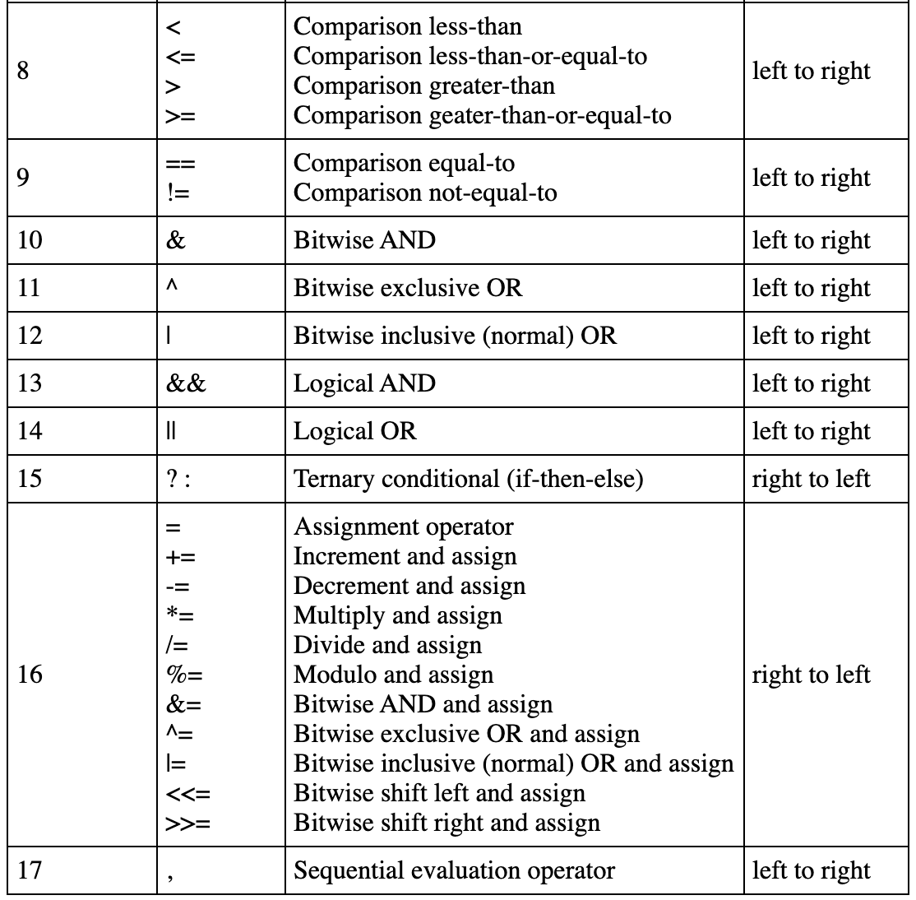
Operators is C++ (Summary)
What are the values of x and y equal to after execution of this instruction (by default x and y equal to 13):
x += y %= (3, 4, 5 * 1 + 2 * 4 - 3)

Slide 39
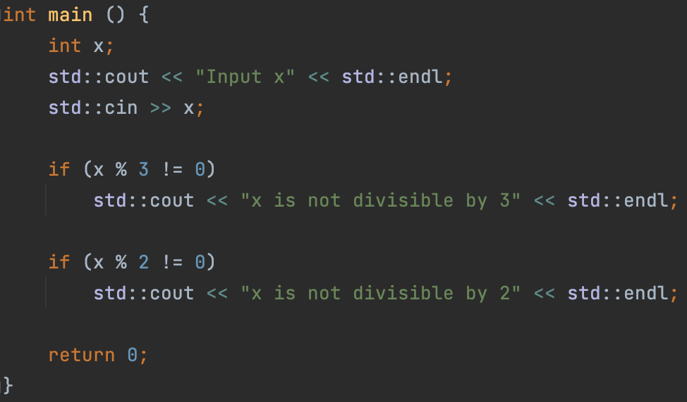
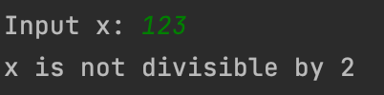
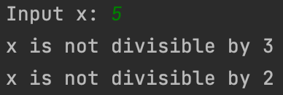
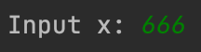
Control sequences
if condition
Syntax :
if (boolean expression or expression, convertible to bool)
statement or composite-statement
Statement will be executed if and only if the expression in parenthesis evaluates to true

Slide 40
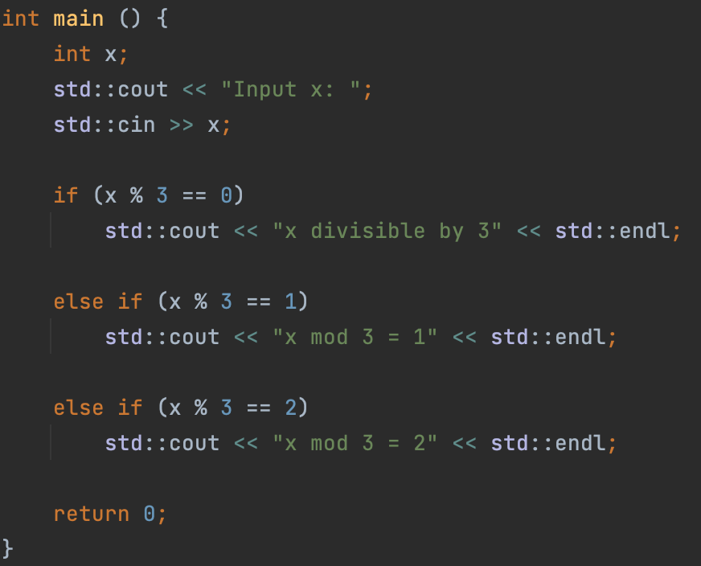
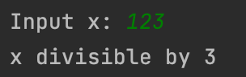
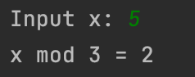
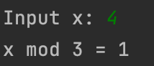
Control sequences
else if condition
Syntax :
Else if statent must follow if statement or else if statement. Otherwise, the program won’t compile.
else if (boolean expression, or expression, convertible to bool)
statement or composite-statement
Statement will be executed if and only if the expression in parenthesis evaluates to true and the expression in parenthesis of the previos if condition evaluates to false and all of the expressions in parenthesis of previous else if conditions also evluates to false

Slide 41
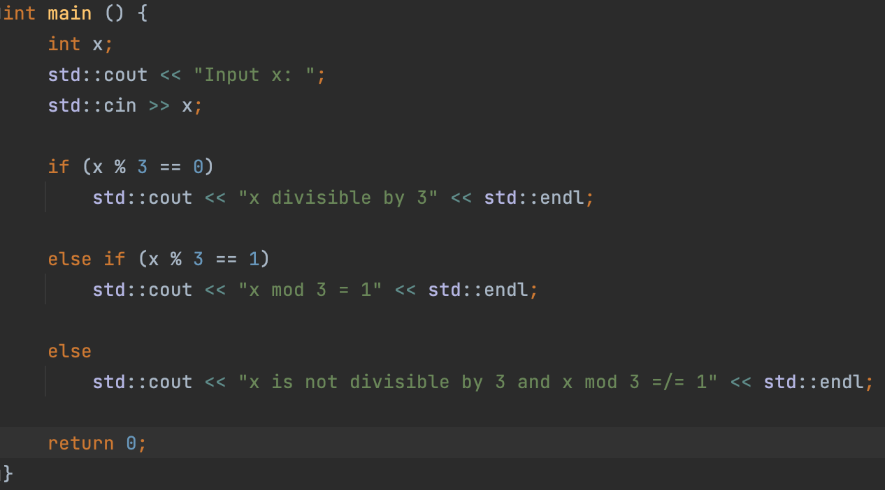
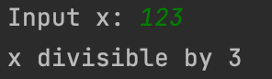
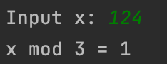
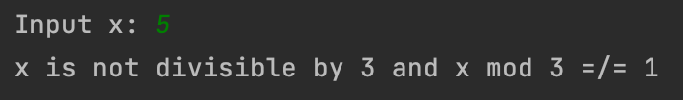
Control sequences
else condition
Syntax:
Else statent must follow if condition or else if condition. Otherwise, the program won’t compile.
else
statement or composite-statement
Statement will be executed if and only if the expression in parenthesis of the previos if condition evaluates to false and all of the expressions in parenthesis of previous else if conditions also evluates to false

Slide 42
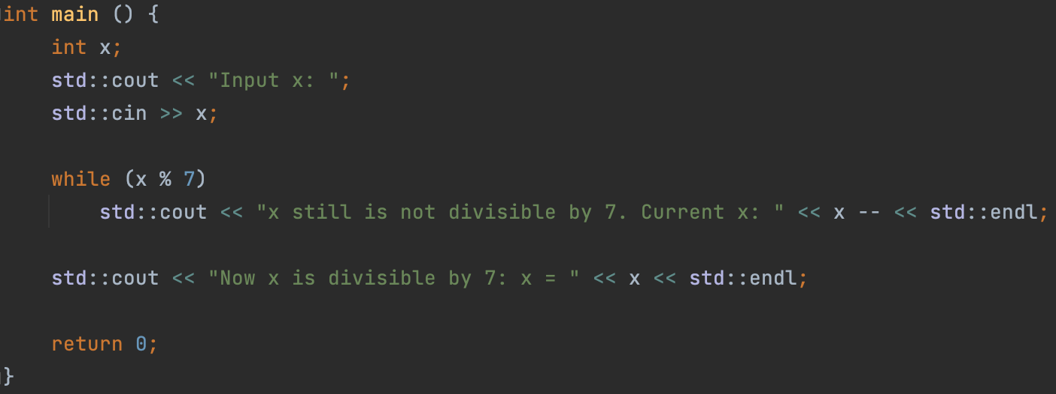
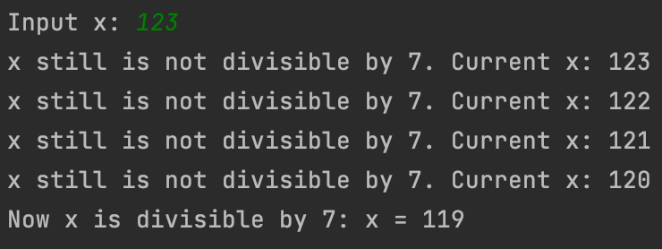
Control sequences
while loop
Syntax:
while (boolean expression, or expression, convertible to bool)
statement or composite-statement
Statement or composite statement will be executed over and over again as long as the condition is true.

Slide 43
Control sequences
while loop
Syntax:
while (boolean expression, or expression, convertible to bool)
statement or composite-statement
Statement or composite statement will be executed over and over again as long as the condition is true.

Slide 44
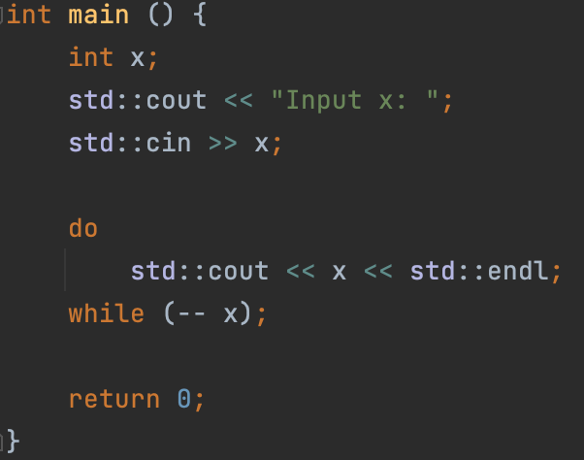
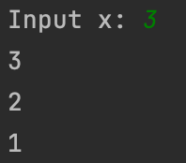
Control sequences
do-while loop
Syntax:
do
statement or composite-statement
while (boolean expression, or expression, convertible to bool);
Statement or composite statement will be executed unconditionally once, then, if the expression in condition evaluates to true, the statement will be executed again, etc...

Slide 45
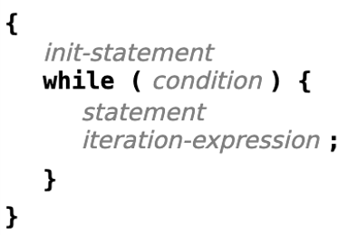
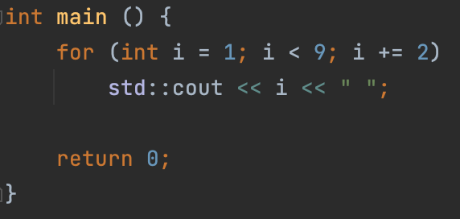
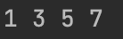
Control sequences
for loop
Syntax:
for (declaration or expr [init statement]; boolean expression [condition]; expression [iter expr])
statement or composite statement
The above syntax produces code almost equivalent to:
Exaple:

Slide 46
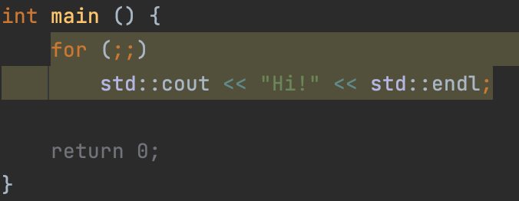
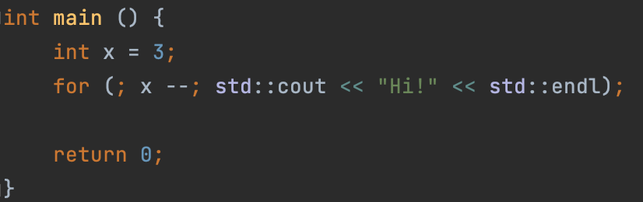
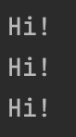
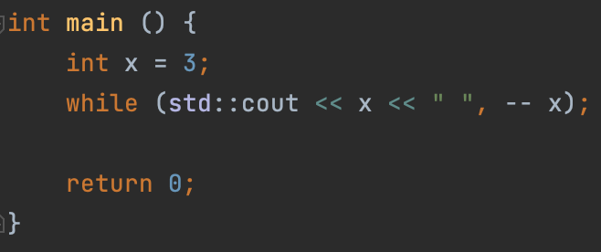
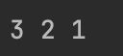
Control sequences
for loop
Every instruction in parenthesis can be omitted.
Also, even statement can be omitted (same as for the while loop)
Infinite for loop:
Omitted statement:
Omitted statement:

Slide 47
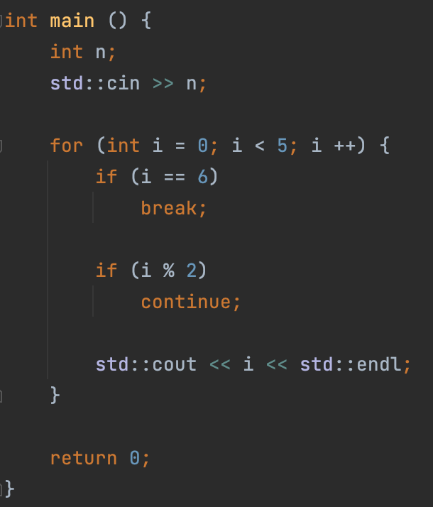
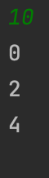
Control sequences
Continue and break keywords
Continue
Unconditionally proceeds to the next iteration of the current loop
Break
Unconditionally terminates the current loop
Important:
break is not the same as return
(lol, how can you possibly confuse them… ?)

Slide 48
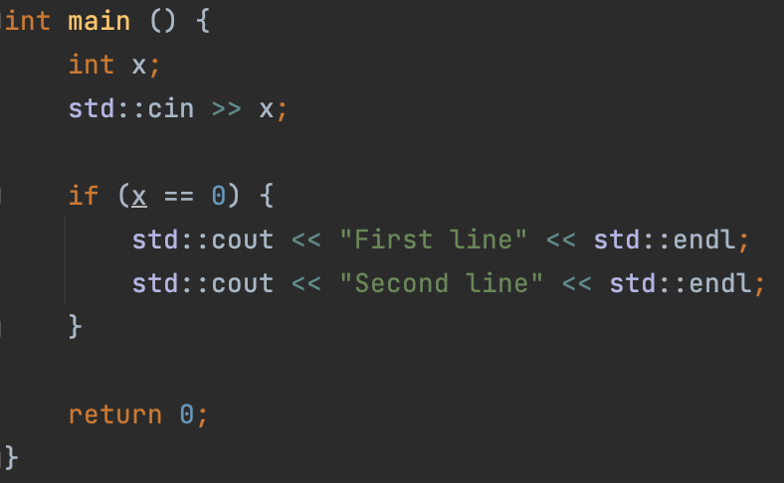
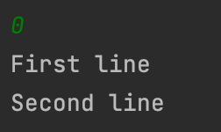
Control sequences
Composite statement examples:

Slide 49
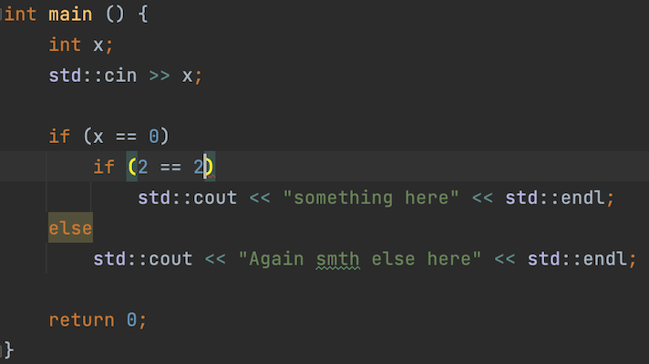
Control sequences
Common mistake:

Slide 50
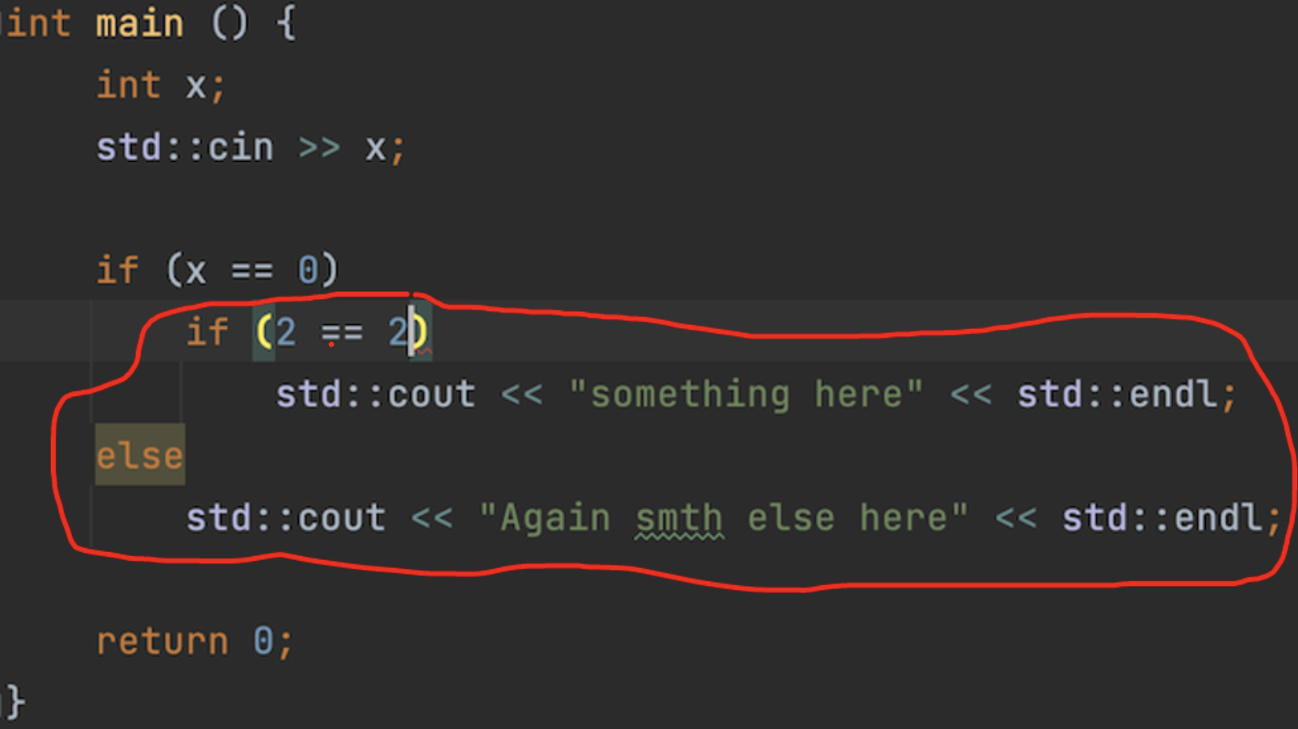
Control sequences
Common mistake:

Slide 51
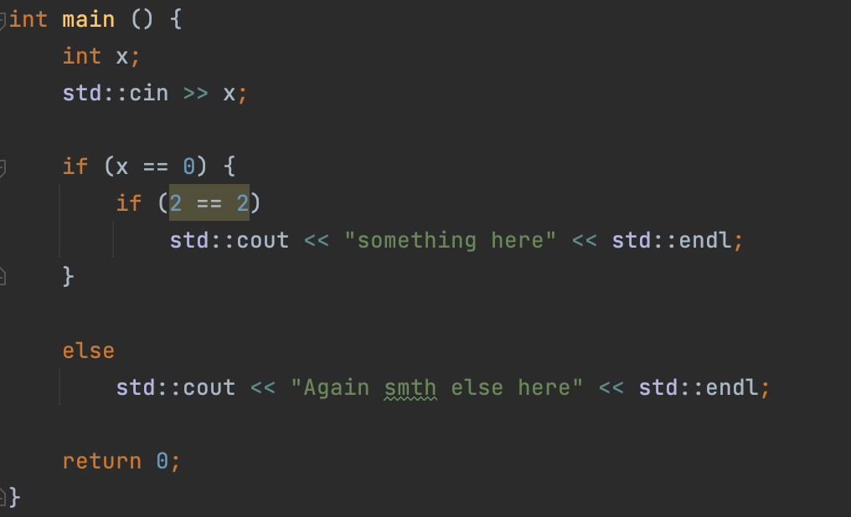


Control sequences
Solution:

Slide 52

Control sequences
How to avoid:
BAD: Always put figure brackets and use composite statements…
GOOD: Memorize how this mechanism works

Slide 53
Control sequences
Switch / case
Nice replacement for if-else if-else when you have similar conditions in parenthesis:
switch (expression) {
case expression:
statements
[break;]
…
default:
statements
[break;]
}

Slide 54

Control sequences
Switch / case
Example:

Slide 55

Control sequences
Switch / case
Example:

Slide 56


Void
If you want to create a function, which will not return anything, you can use void as a return type:
But still, you can return return keyword:

Slide 57

ASCII table

Slide 58



ASCII table
Prints 97:
Arithmetics:

Slide 59


Qualifiers
const qualifier:
Variables declared with const-qualified types are not modifiable. In particular, they are not assignable:
RULE
If you are not going to change the value of a variable, add const-qualifier to it. This will help you to avoid mistakes, because if you try to change the value, the code will not compile.

Slide 60
Types of errors in C++
Compilation error is a situation in which the compiler cannot convert your code to executable.
Lexical error - the written code cannot be recognized by the compiler
Syntax error. Natural language example: a sentence written from random words.
Semantic error: The written text is correct, but it makes no sense. example from natural language: "Eat, please, that table." You cannot make sense and cannot complete the task given to you with the given objects.
Runtime errors can't be predicted at compile time:
Access to unallocated memory.
Stack overflow. stack memory overflow (will discuss later, but a simple example is infinite recursion)
Undefined behaviour (UB):
This is when we write something that the C ++ language standard does not say anything about.

Slide 61
Practice
Problem 1:
Input a number and output it’s bits in a sequence.

Slide 62
Practice
Problem 2:
Find the sum of squares of numbers from 1 to N
Input:
4
Output:
30
Explanation:
1^2 + 2^2 + 3^2 + 4^2 = 1 + 4 + 9 + 16 = 30

Slide 63
Practice
Problem 3:
Find the hypotenuse of a triangle (legs are given)
Input:
3 4
Output:
5

Slide 64
Practice
Problem 4:
Find max and min of two numbers without using conditions
Input:
3 4
Output:
4 3

Slide 65
Practice
Problem 5:
Find the number of paired bits in the binary representation of an integer
Input:
3
Output:
2

Slide 66
Practice
Problem 6:
Let’s consider sets of:
Digits [10]
Latin letters (both capital and lowercase ones) [26 + 26 = 52]
+
-
Implement the next functions:
Input the set
Output set
Unite two sets
Intersect two sets
Invert set
Calculate symmetric difference between two sets
Calculate difference between two sets

Slide 67
Arrays
Variable is like a cell in a storage room
But what if we want to take an arbitrary amount of these cells?
a =
124 | 5326 | 37345 | 34 | 15 | -12
An array is special type of a variable. It contains several variables of the same type at once.
Moreover, the elements of the array are ordered - each has its own number.
Only the entire array has a name, the elements have only an ordinal number in this array

Slide 68
Arrays
Items are numbered starting at zero. The number of an element in an array is called its index
0 | 1 | 2 | 3 | 4 | 5
124 | 5326 | 37345 | 34 | 15 | -12
Array size is 6!
a =
You can think of the index as the distance from the leftmost element. On the ruler, lines are also numbered from zero.
An array element is accessed through square brackets: a [i]
std::cout << a[1] << std::endl;
a[2] = 0;
a[3] = a[2] + a[1];
std::cout << a[3] << std::endl;

Slide 69
Arrays
When creating an array, you need to specify its size:
int a[6];
By default, as in the case of an uninitialized variable, all array elements contain so-called garbage. That is, each element has no specific meaning. Therefore, the arrays need to be initialized:
a[0] = 1;
a[1] = 2;
a[2] = 3;
a[3] = 4;
a[4] = 5;
a[5] = 6;
Array and for loop are best friends =)
Let's try to initialize the array with numbers from 1 to 10:
int a[10];
for (int i = 0; i < 10; i ++)
a[i] = i + 1

Slide 70
Practice
Task 1: A sequence of n numbers is entered on the keyboard. Print numbers in reverse order.
Input: First, the number n itself, then a sequence of n numbers
Output: The same n numbers in reverse order
Task 2: A sequence of n numbers is entered on the keyboard. Determine if it is a palindrome.
Input: First, the number n itself, then a sequence of n numbers
Output: Whether the string is a palindrome or not
Task 3: A number n is given, which is the size of a square matrix. It is necessary to assign to each diagonal its distance from the main one.
Input: the number n
Output: the required matrix

Slide 71
Arrays and const qualifiers
If we combine array modifier and const qualifier, we’ll create a const-qualified array.
const int a[6];
But in this case, we’ll get a compilation error, because a is uninitialized.
In order to initialize it, we should use initializer lists:
const int a[6]{1, 2, 3, 4, 5, 6};
or:
const int a[6] = {1, 2, 3, 4, 5, 6};

Slide 72
Declaration point of an array
int x[x];
Compilation error, x is undefined.
int x = 2;
{
int x[x];
}
Ok, array size is 2

Slide 73
Arrays
I would like to be able to use arrays even if the size is large.
In the case of a regular array, if you use a large size, a RunTime Error (Segmentation Fault) will occur.
int a[150]; /// OK
int a[10000000]; /// RE
So how to create large arrays?
Also:
a [150] = 3;
This code will work, but why ???
Moreover, even the following code works: a[-5] = 4;
Let's figure out what happens at the physical level.

Slide 74

What happens at the physical level
When a program is launched, the operating system allocates a fixed amount of memory in the computer's RAM. This is usually 4-8 megabytes.
When you declare something in your program, a certain number of bytes is reserved is the special memory area.

Slide 75

What happens at the physical level
Another example:

Slide 76

What happens at the physical level
Example with an array (note, that array is placed on the stack in the reversed order):

Slide 77

What happens at the physical level
The area of ​​memory discussed is called the stack.
What happens when you access a[5]? The executor understands that he needs to take the sixth element of the array. Now, let's imagine that he has a "coordinate” of the first element of this array a in memory. Then, to get the sixth element of the array, he needs to add 5 to this coordinate, or, in other words, shift it 5 steps to the right. However, you need to take into account that each step must be exactly sizeof(int) = 4Bytes wide.

Slide 78

Pointers
We smoothly arrived at the concept of a pointer. What it is?
Pointer is a special data type that is used to represent different addresses in memory.
A memory address is a hexadecimal number representing a coordinate in memory:
int* x; ← pointer to int, type of x is int*
int* is a type which stores the memory address in which the int x lies.

Slide 79


Operations with pointers
1) Unary operator &, aka address-of (don’t confuse with the binary bitwise operator &).
Returns the address in memory at which the variable is located.
precedence: 3
associativity: right-to-left
2) Unary operator *, aka dereferencing
Returns the value to which the pointer is pointing.
precedence: 3
associativity: right-to-left

Slide 80


Operations with pointers
3) Incrementing / decrementing pointers.
By adding a number to the pointer, you shift this number of steps to the
right (if the number is positive), or to the left (if the number is negative).

Slide 81


Operations with pointers
4) Difference of two pointers.
By subtracting two pointers, you will know the distance between them in memory.
But this distance will NOT be in the number of bytes, but in the number of elements
of the pointer type.
So, to find out the number of bytes between two pointers to double, for example, you need to multiply the difference of pointers by sizeof(double).

Slide 82


Operations with pointers
5) Operator [], aka subscript operator.
Applies to arrays. a[i] returns the array element with index i.
Precedence: 2
Associativity: left-to-right
Let’s try to print address of an array and its elements.
We see an important property: the address of the array coincides with the address of the element with index 0 in it, and the distance between adjacent elements is always 1.

Slide 83

Operations with pointers
In fact, when the [] operator is applied to the array a, the result is calculated as follows:
Finally, we understand why the first element in the array has index 0!

Slide 84



Operations with pointers
It is possible to access memory not associated with the current array.

Slide 85
Dynamic memory
You cannot allocate very large arrays, because the stack size is limited. But how, then, to create very large arrays ?! For example, a size of 10,000,000 items. The solution is the so-called dynamic memory. The fact is that there is a tool with which you can ask your OS to give you more memory than you currently have available (usually 4-8 megabytes are available).
This is the new and delete operators, which allocate and deallocate heap respectively. Heap memory is located not on the stack, but in another area called the heap.

Slide 86
Operators new and delete
Operators new and delete have two versions:
The first is used to allocate and deallocate one value (cell).
The second is to allocate and deallocate an entire array (sequence) of cells.
Operator new:
Allocates new one cell.
Operator delete:
Deallocates one cell.
Operator new[]:
Allocates new chunk (array) of cells (amount should be provided)
Operator delete[]:
Deallocates new chunk of cells (amount should be provided)
Precedence: 3
Associativity: right-to-left
RULE: All memory allocated by your program must be deallocated!

Slide 87


Operators new and delete, syntax
One cell:
3 is a value which will be used to initialize the variable x
Array:
4 in this case is the size of the array, not the value of it!

Slide 88


Operators new and delete
Now is the time to talk about how to declare arrays that do not end in curly braces.
Example: allocating an array in a function and returning it from a function.
In fact, this can also be done with dynamic memory and using the new and delete operators!

Slide 89



Example
Input two arrays of doubles and output sum of these arrays.

Slide 90


Const qualifier and pointers
Let me remind you that C ++ has a const keyword, which is a variable qualifier. If we create a variable and add the const qualifier to it, that variable cannot be modified.
The const qualifier can be applied to pointers too! However, in this case there is a question: what exactly will we prohibit modifying if we add the word const: the pointer itself (address), or the value it points to ?! In fact, pointers are of four types:
A regular pointer. You can modify both its value and the value to which it points.
Constant pointer. Modifying its value is not possible, but it is possible to modify the value to which it points.
Constant pointer. Modifying its value is possible, but it is not possible to modify the value to which it points
A constant pointer to a constant. Modifying neither the value of the pointer nor the value to which it points is allowed.

Slide 91

Const qualifier and pointers
A pointer to a const returns a const when dereferenced.
A pointer to a const cannot be assigned to an normal pointer, but vice versa is allowed.
Conclusion: any operation should not underpromote (get rid of) the const qualifier.

Slide 92


Swap
Let's imagine the following problem: we want to swap the values ​​of variables.
Moreover, we want to create exactly the function that will do this.
Formally, we want to create a function that will take two variables and swap their values.
Let's try to implement such a function.
But it doesn’t work =(
Why?

Slide 93


Swap
When we pass an argument to a function by value (as in the previous example), in fact, we are creating a copy of the variable, and not passing this particular variable! So, in previous implementation of the swap function, we do not work with the initial variables x and y, but with their copies.
But how, then, can we access the original variables x and y!? Well, for example, we can pass the addresses of these variables to the function, and not just copy their values! To do this, let's change the signature of the swap function to receive pointers to the original two variables, not copies of them!
And this time everything works as it should!

Slide 94

Swap
We can improve the code a bit by keeping the const rule, which states: everything that can be const must be const.
For example, in this problem, we can make const pointers (but NOT pointers to const).

Slide 95

References
In fact, before the invention of C ++, the method I showed was the only method for passing initial variables to functions. This method is not very simple, as it requires a lot of dereferencing and address-of operations. In addition, you always need to make sure everything is fine with the pointer. For example, if you accidentally delete an object and then refer to it by the pointer, it’ll be an UB:
But with the invention of C ++, everything changed and the concept of references emerged.

Slide 96




References
In Python, for example, if we create a list and create a variable to which we assign the value of this list, we will NOT copy the list, but create a reference to it!
You will find similar behavior in some cases in Java, JavaScript, TypeScript, and many other programming languages. In them - the concept of a link is built into the language, but you have a way to control whether to create a reference to an object, or make a copy of it.
Similarly in C ++, we can create references to objects (variables). However, in C ++, by default, the copy is getting created, not creating a reference. This is what distinguishes C ++ from Python and the other languages ​​listed above.

Slide 97



References
To create a reference to a variable in C ++, you must use the ampersand character in declaration (not to be confused with the address-of operator!)
& here denotes a modifier of type int (as in the case of a pointer). That is, the type of variable b is int & (not int!).
Now, any action with variable b will also change variable a!

Slide 98

References
References can be passed to functions. In this case, we will NOT create a copy, but pass the variable itself to the function. This way we can change the value of the original variable without using pointers!
In this case, everything is fine

Slide 99

References
Moreover, references can not only be received by functions, but also returned from them!
However, this trick will be useless to us before we look at classes.
Moreover, there is one very serious mistake associated with this that many programmers make: returning a reference to a local object from a function

Slide 100



Const qualifier and references
Just like with pointers, we can create references to constants. In this case, the rule from the first slide is also fulfilled.
Another rule: const and reference must always be initialized
Another example:

Slide 101

Casts
There is a so-called C-style cast operator, which allows you to convert variables of different types. But how exactly does this transformation work?
In fact, the C-style cast operator isn’t quite often used nowadays, because its behavior is not specific enough.
Instead, in new versions of C ++, 4 new operators are used, of which today we will discuss only 3.

Slide 102



Casts
static_cast: This is a compile-time conversion. If static_cast fails to convert the original variable to the correct type, we will get a compilation error.
reinterpret cast - byte-level conversion. C ++ will simply stop treating the original object as the type it was originally, and will hang a new type on it. This is the lowest-level conversion you can do in C ++. You should be careful with it, and use it only in the most special cases. In the next lesson, I'll show you an example.

Slide 103


Casts
const_cast is a conversion "through" a constant. This is the only cast that violates the underpromotion rule. You have to be careful with const_cast because it can lead to an error.
dynamic_cast is a run-time conversion that is applied to polymorphic (virtual) types. We'll be talking about it in the next semester.

Slide 104

Problem
A sequence of 2D points is specified as a sequence of pairs (x, y).
It is necessary to find the perimeter of the polygon formed by a given set of points.
Points are given in order of counterclockwise traversal relative to the center of the polygon.

Slide 105
Lecture 1
Basics
C++ Programming
Konstantin Leladze
FCS HSE 2022

